Slide 1


Hitesh Tolani
3-2-2022

Slide 2
Table of Contents
Topic | Slide Number
Executive Summary | 3 & 4
Introduction | 5
Methodology | 6 to 22
Results | 52 & 53
Conclusion | 54
Appendix | 55

Slide 3
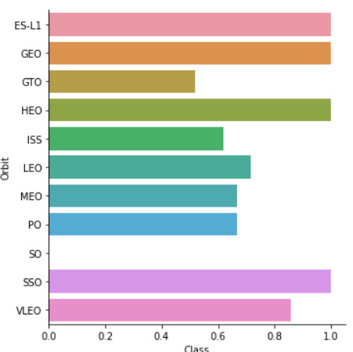
Executive Summary
Data Collection
Data is mainly collected using SpaceX Rest API . The endpoints of SpaceX REST API start with api.spacexdata.com/v4/
Data Wrangling
In the dataframe , the column outcome has 8 possible values (True Ocean , False Ocean , True RTLS, False RTLS , True ASDS , False ASDS , None ASDS and None None).
EDA using Visualization and SQL

Slide 4
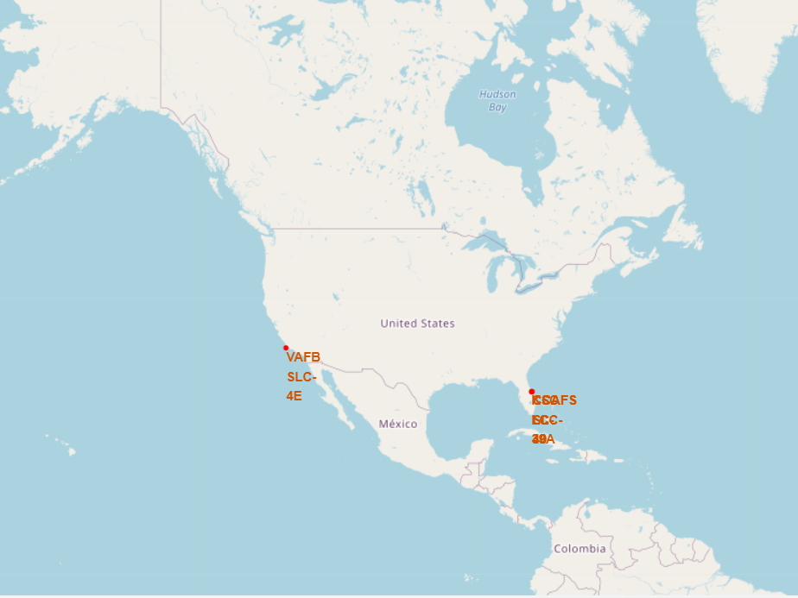
Executive Summary
Interactive visual analytics using Folium and Plotly Dash
Predictive analysis using classification models
We trained a KNN model with ~84%,this was found to be the performing model which
was then used to predict the success rate of the launches

Slide 5
Introduction
We will try to determine if the first stage will land successfully.Space X advertises Falcon 9 rocket launches on its website with a cost of 62 million dollars; other providers cost upward of 165 million dollars each, much of the savings is because Space X can reuse the first stage. Therefore if we can determine if the first stage will land, we can determine the cost of a launch. This information can be used if an alternate company wants to bid against space X for a rocket launch.
Problems that need to be solved.
What is the best booster version?
What is the most suitable orbit for launches?
What is the most suitable launch site?

Slide 6

Section 1

Slide 7
Data Collection Methodology
Data is mainly collected using SpaceX Rest API.
The API will provide us data regarding rockets used, payload delivered , launch specifications , landing specifications and landing outcome of launches
The endpoints of SpaceX REST API start with api.spacexdata.com/v4/

Slide 8
Data Collection Methodology
After Data is collected using SpaceX REST API ,the data is normalized and then convert into pandas dataframe for further analysis.
Another source used for data collection is wikipages for extracting Falcon 9 launch data .

Slide 9
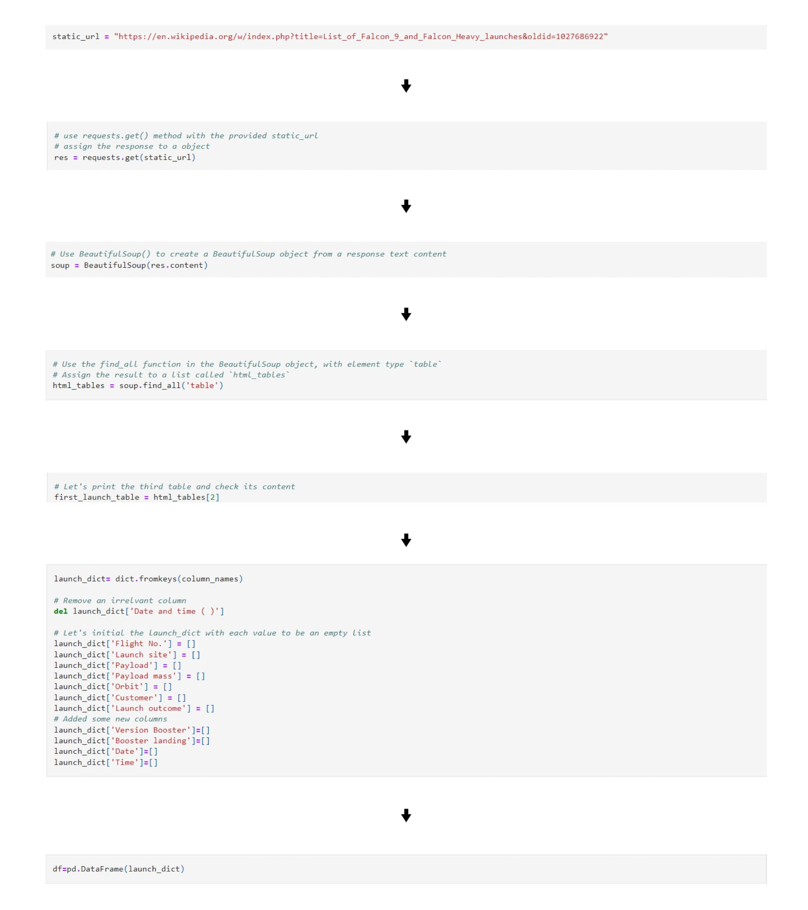
Data Collection SpaceX API
Notebook

Slide 10
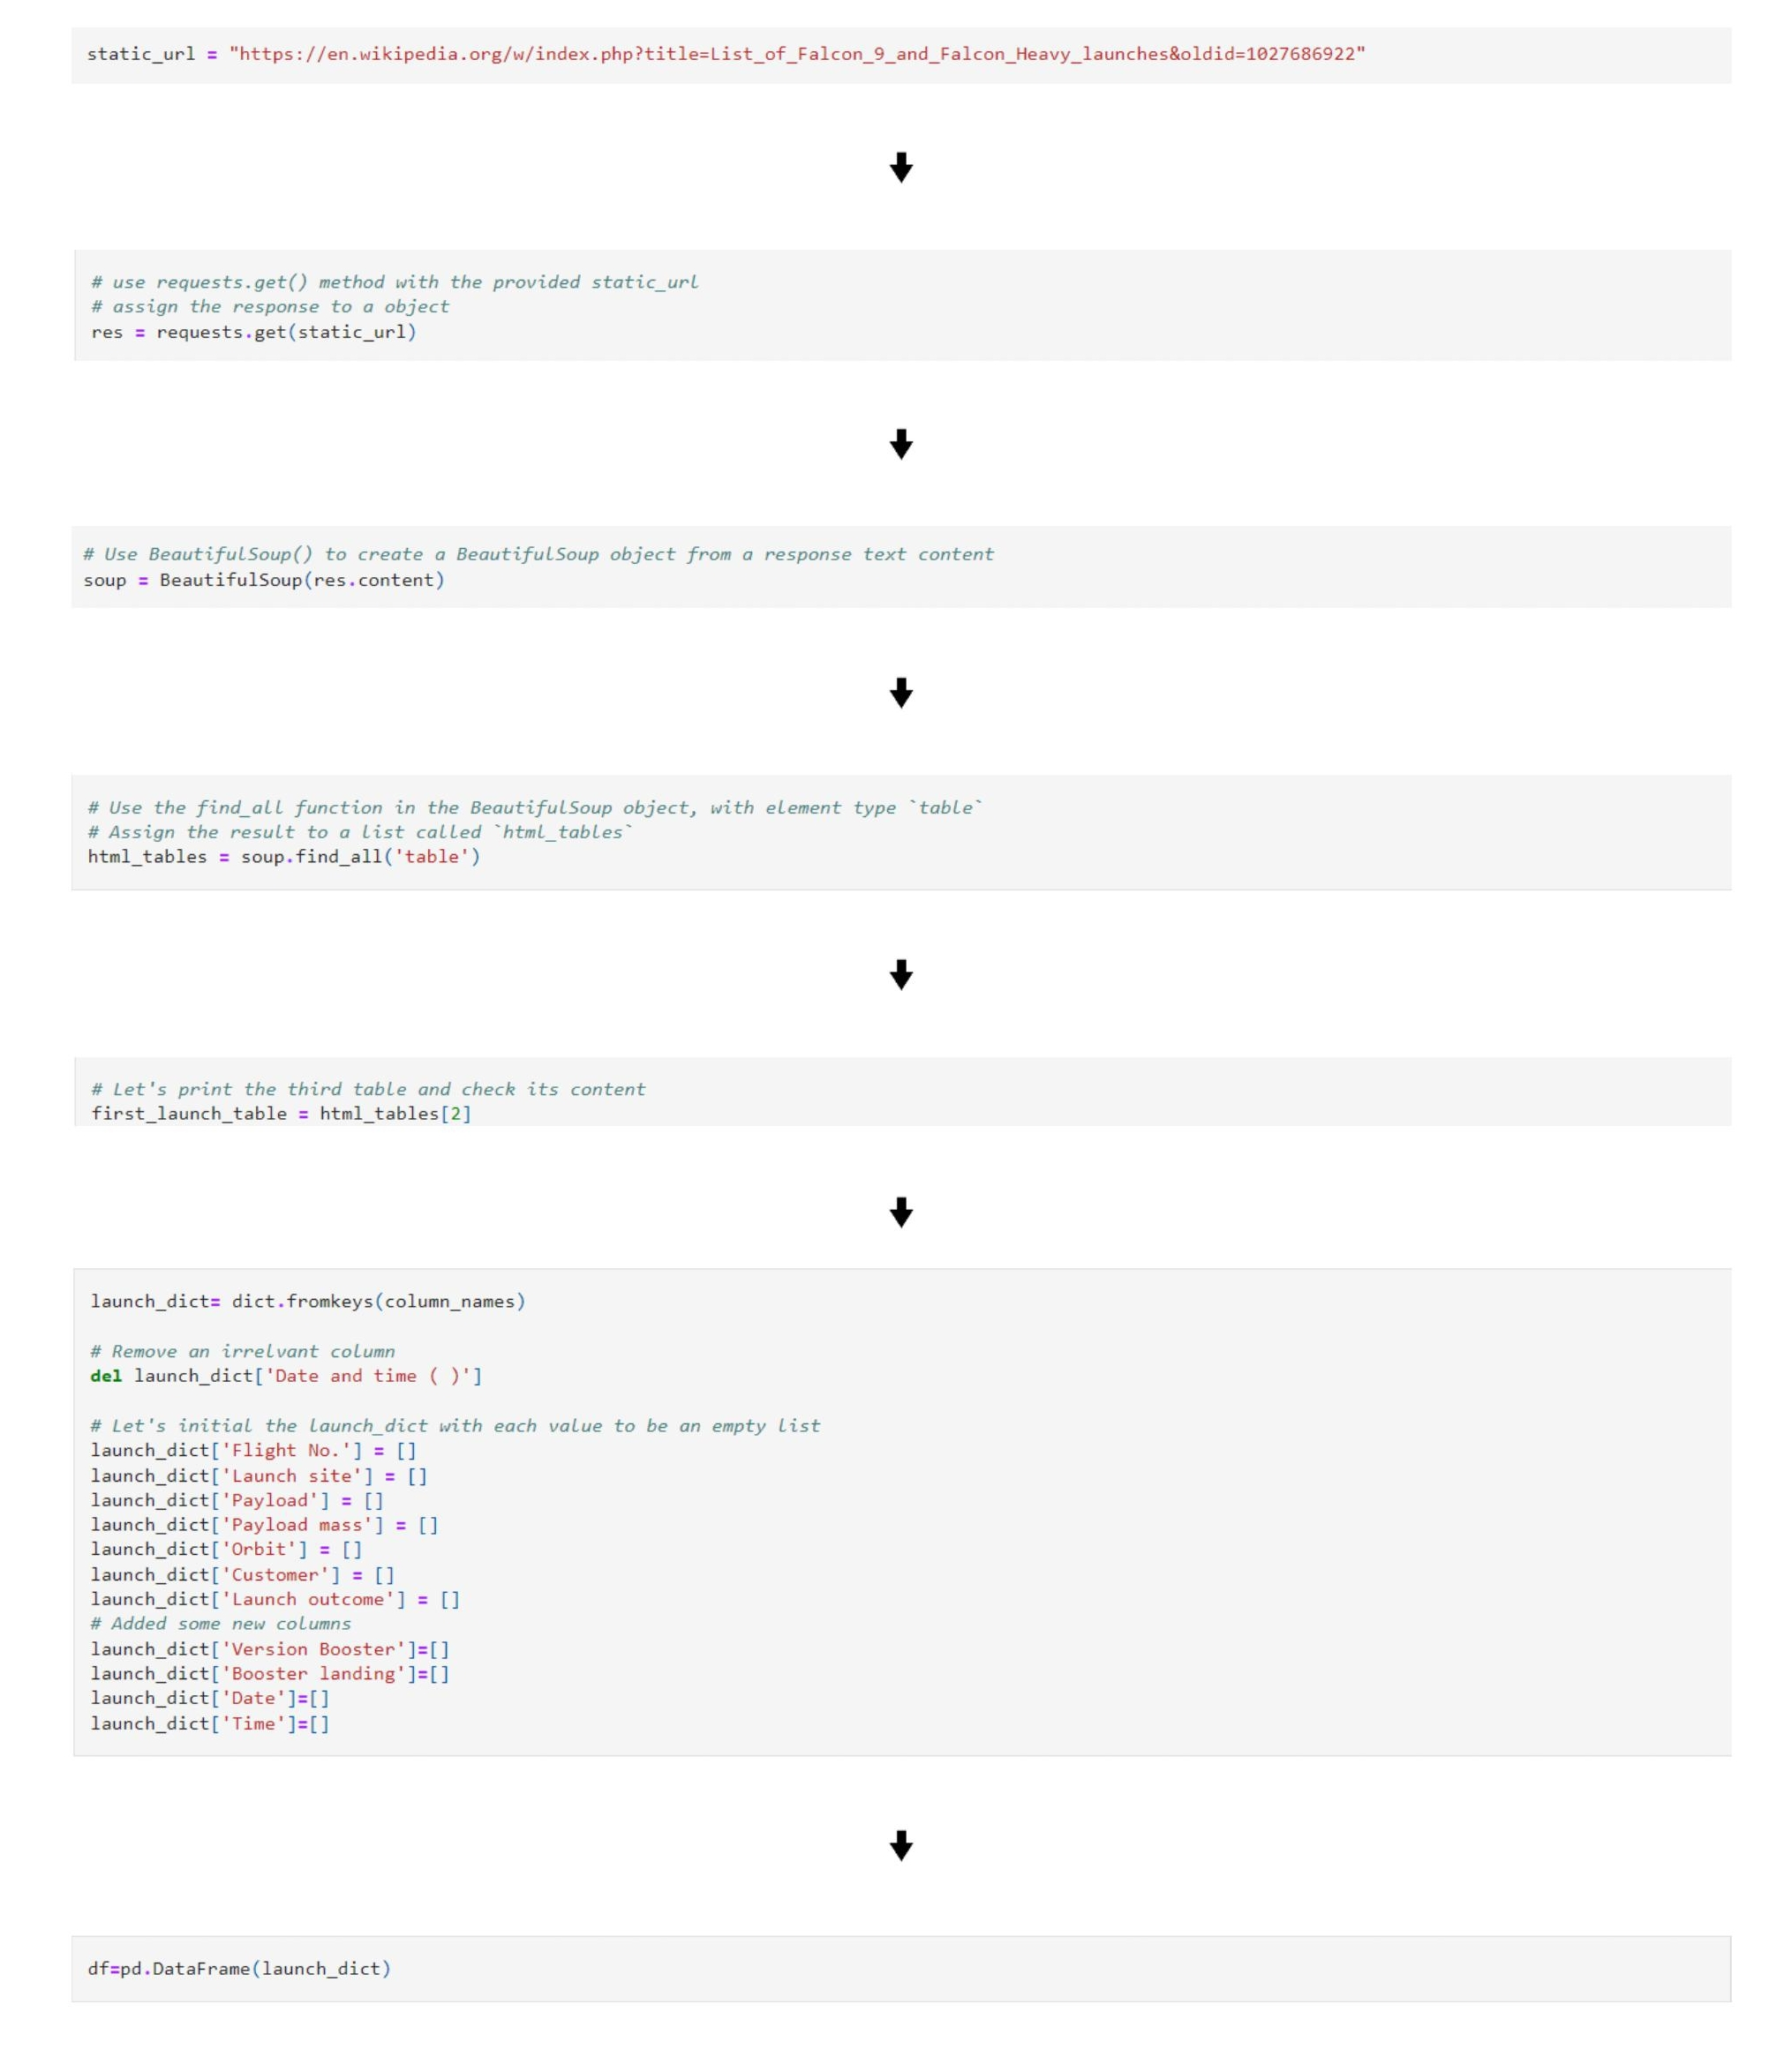
Data Collection Scraping
Notebook

Slide 11
Data Wrangling
In the dataframe , the column outcome has 8 possible values (True Ocean , False Ocean , True RTLS, False RTLS , True ASDS , False ASDS , None ASDS and None None).
True Ocean means the rocket was landed successfully to
a specific part of ocean. False Ocean means the rocket
was landed unsuccessfully to a specific part of ocean.

Slide 12
Data Wrangling
True RTLS means the rocket was landed successfully to
a ground pad. False RTLS means the rocket
was landed unsuccessfully to a ground pad .
True ASDS means the rocket was landed successfully to
a drone ship. False ASDS means the rocket was
landed unsuccessfully to drone ship.
None ASDS and None None means the rocket was landed unsuccessfully.

Slide 13
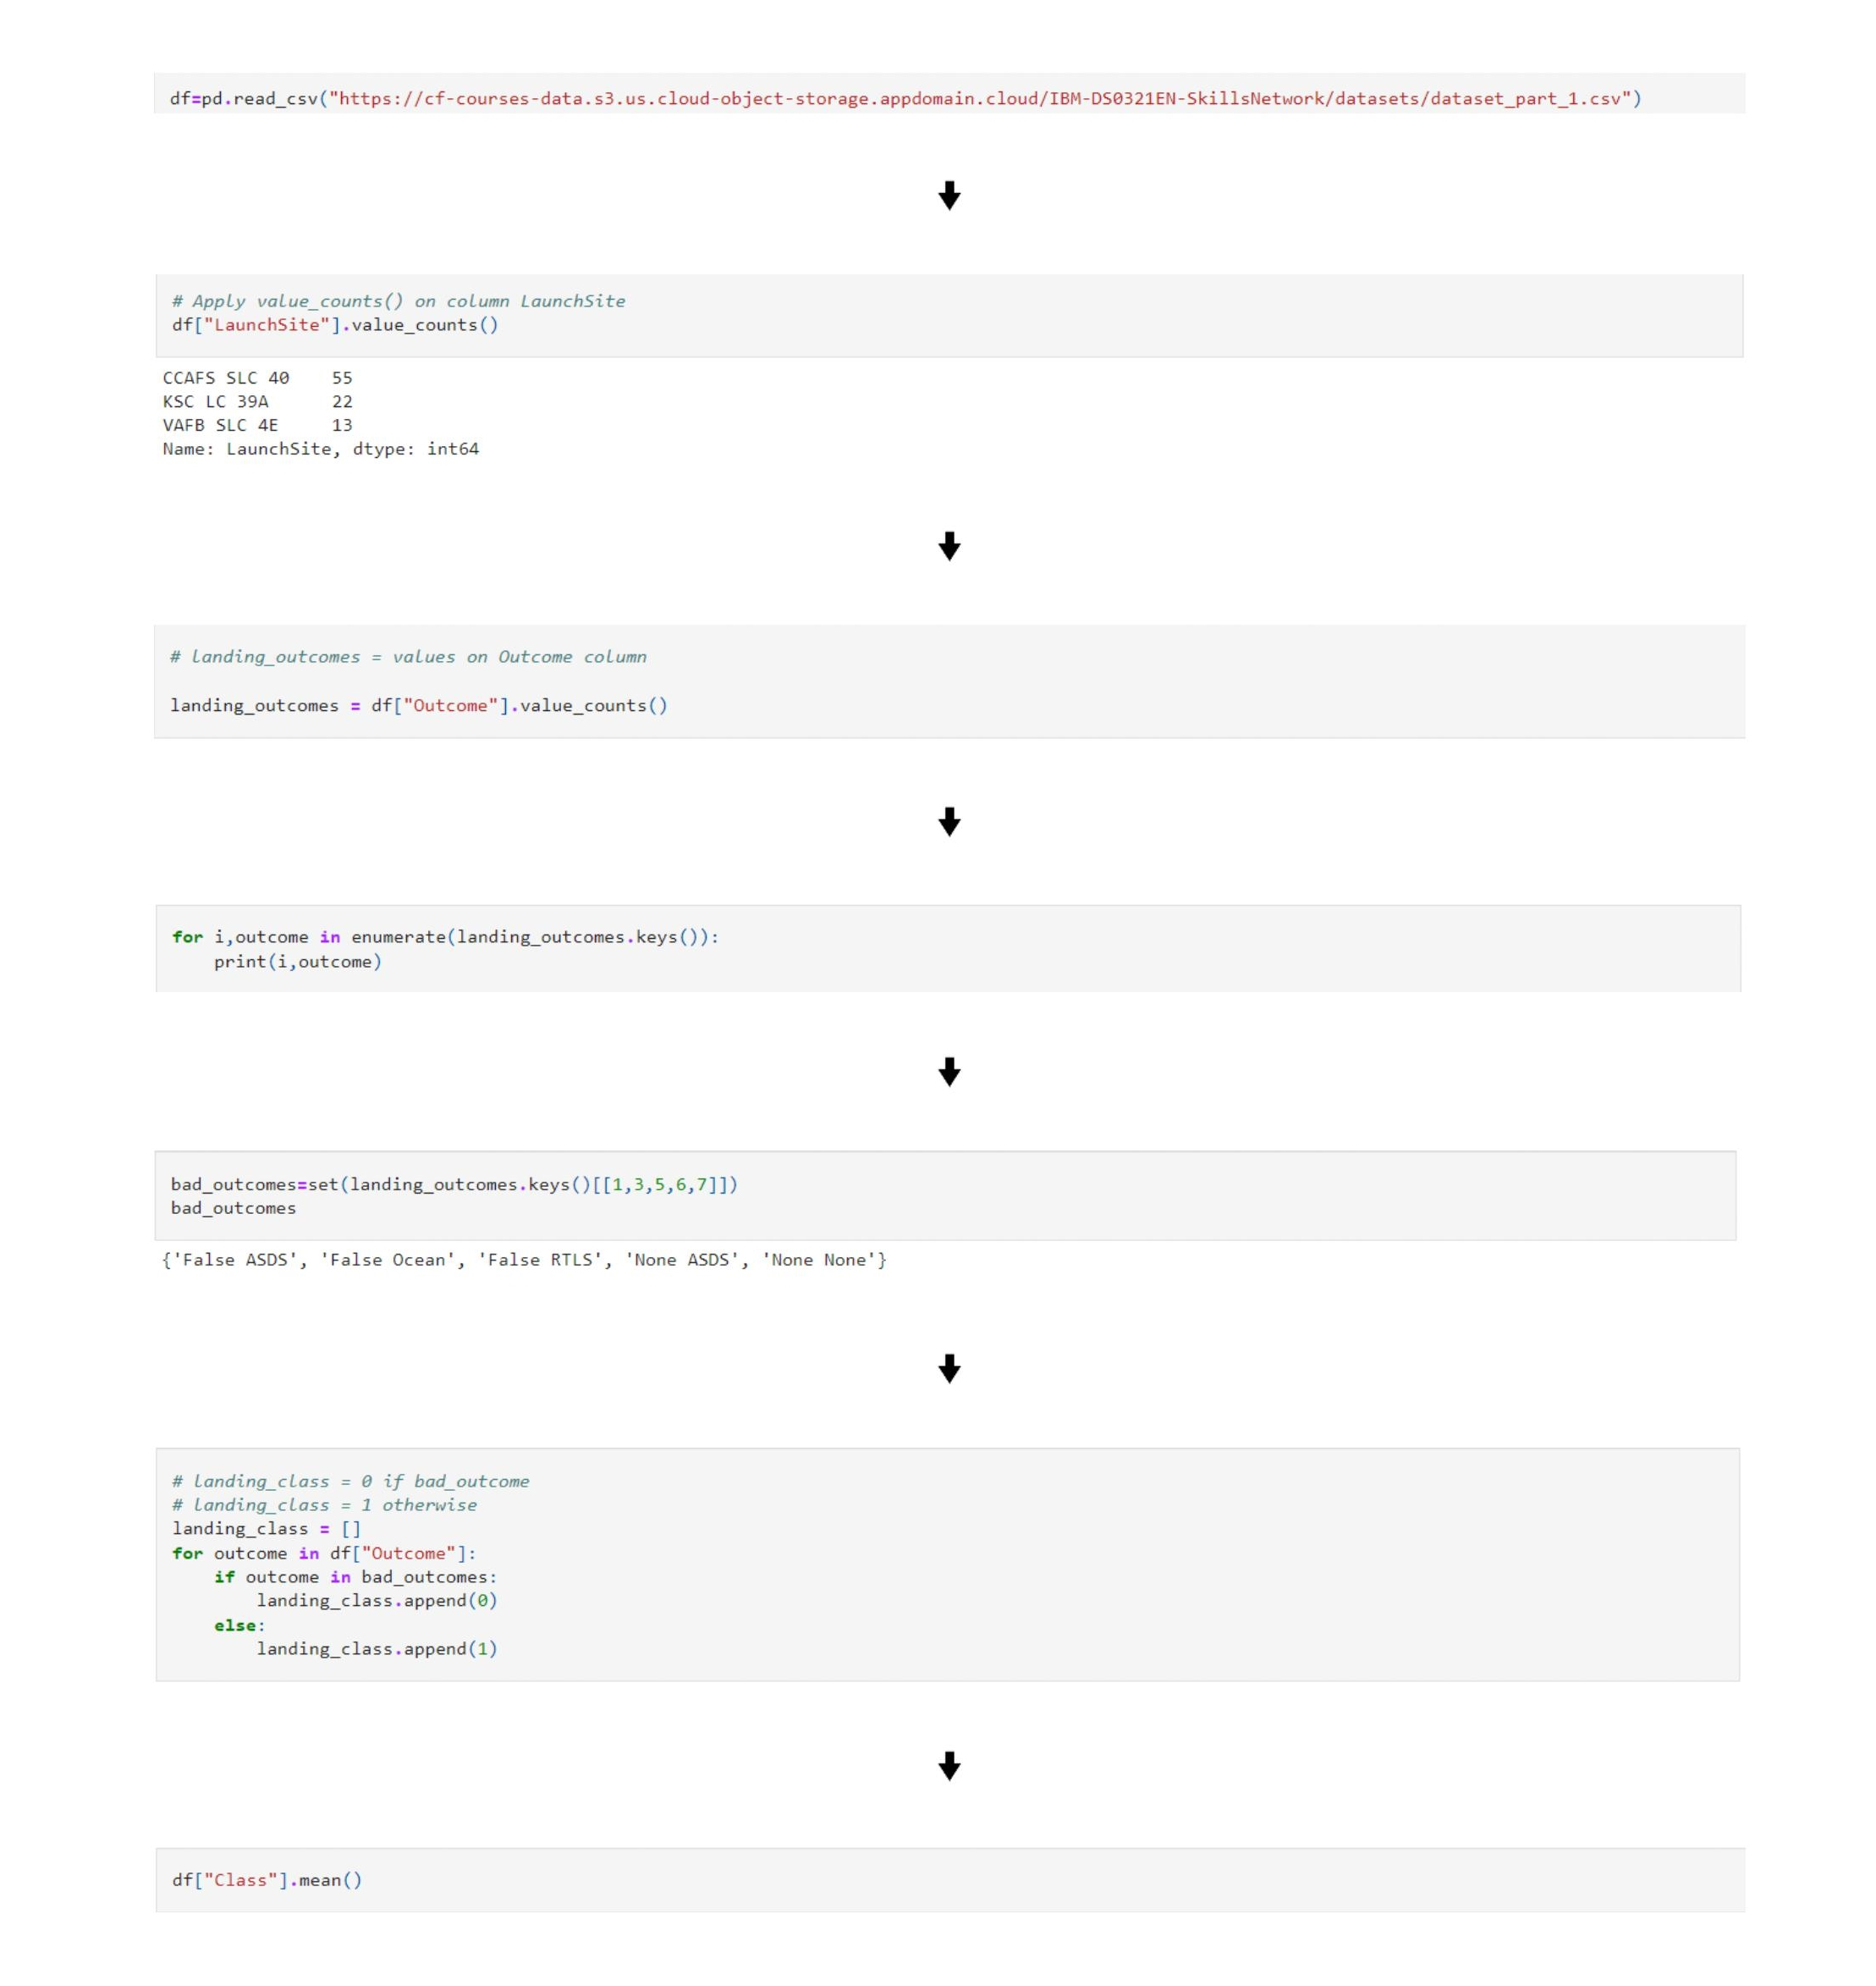
Data Wrangling
Notebook

Slide 14
EDA with Data Visualization
Scatter Plot :
It is used to represent the correlation between the variables in the dataset .
Bar Plot :
It is used to presents categorical data with rectangular bars with heights or lengths proportional to the values that they represent.
Line Plot:
It displays data as marks above a number line , showing the frequency of each value.
Scatter Plot plotted:
Flight Number VS Launch Site
Payload VS Launch Site
Flight Number VS Orbit type
Payload and Orbit type
Bar Plot Plotted :
Orbit vs Success Rate
Line Plot Plotted:
Success Rate VS Year
Notebook

Slide 15
EDA with SQL
The following SQL queries where used to perform EDA on the dataset:
Display the names of the unique launch sites in the space mission.
Display 5 records where launch sites begin with the string 'CCA‘.
Display the total payload mass carried by boosters launched by NASA (CRS).
Display average payload mass carried by booster version F9 v1.1.
List the date when the first successful landing outcome in ground pad was achieved.
List the names of the boosters which have success in drone ship and have payload mass greater than 4000 but less than 6000.
List the total number of successful and failure mission outcomes.
List the names of the booster_versions which have carried the maximum payload mass. Use a subquery.
List the failed landing_outcomes in drone ship, their booster versions, and launch site names for in year 2015.
Rank the count of landing outcomes (such as Failure (drone ship) or Success (ground pad)) between the date 2010-06-04 and 2017-03-20, in descending order.
Notebook

Slide 16
Build an Interactive Map with Folium
All launch sites where marked on the map.
Circles were added to highlight a circle area and add label to it.
Marker Cluster was used to mark successful and failed launches on the map.
Polyline was used to represent the distance between the
launch site and coastline.
Are launch sites in close proximity to railways? Yes.
Are launch sites in close proximity to highways? Yes.
Are launch sites in close proximity to coastline? Yes.
Do launch sites keep certain distance away from cities? Yes.
Notebook

Slide 17
Build a Dashboard with Plotly Dash.
Pie Chart :
A pie chart is a circular statistical graphic, which is divided into slices to illustrate numerical proportion. In a pie chart, the arc length of each slice, is proportional to the quantity it represents.
A pie chart was plotted to examine the number of successful launches per site.
Scatter Plot :
It is used to represent the correlation between the variables in the dataset .
A scatter plot was plotted to represent the Success rate VS payload mass
Of each booster version category.
Notebook

Slide 18
Predictive Analysis (Classification)
The model was built using python’s sci-kit learn library and with
the help of pandas and numpy library.
The dataset was splitted into train and test parts with the test
dataset containing 20% of the original dataset.
Cross-validation and Hyper parameter tuning was done with
help of GridSearchCV with cv being equal to 10.
The best model was picked with help of best_params_ which
was found to be KNN with accuracy of 83%.

Slide 19
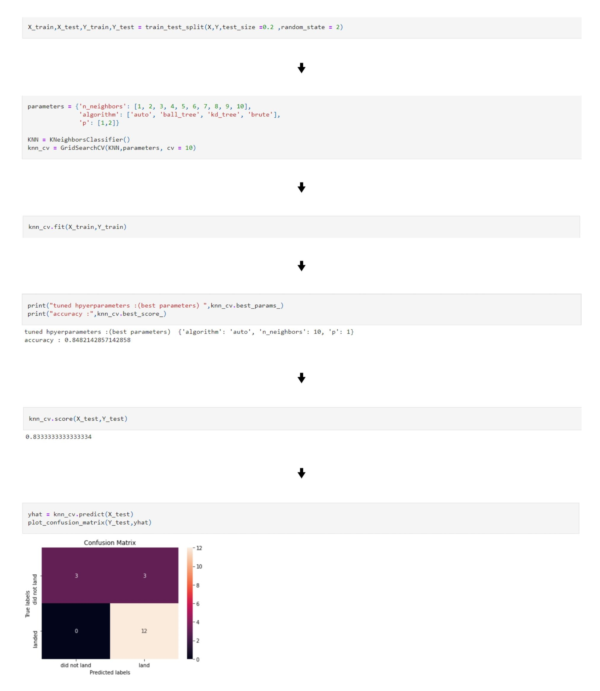
Predictive Analysis (Classification)
Notebook

Slide 20
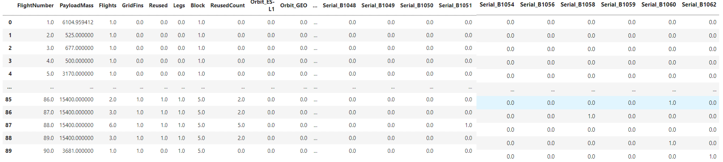
Results
Exploratory Data Analysis

Slide 21
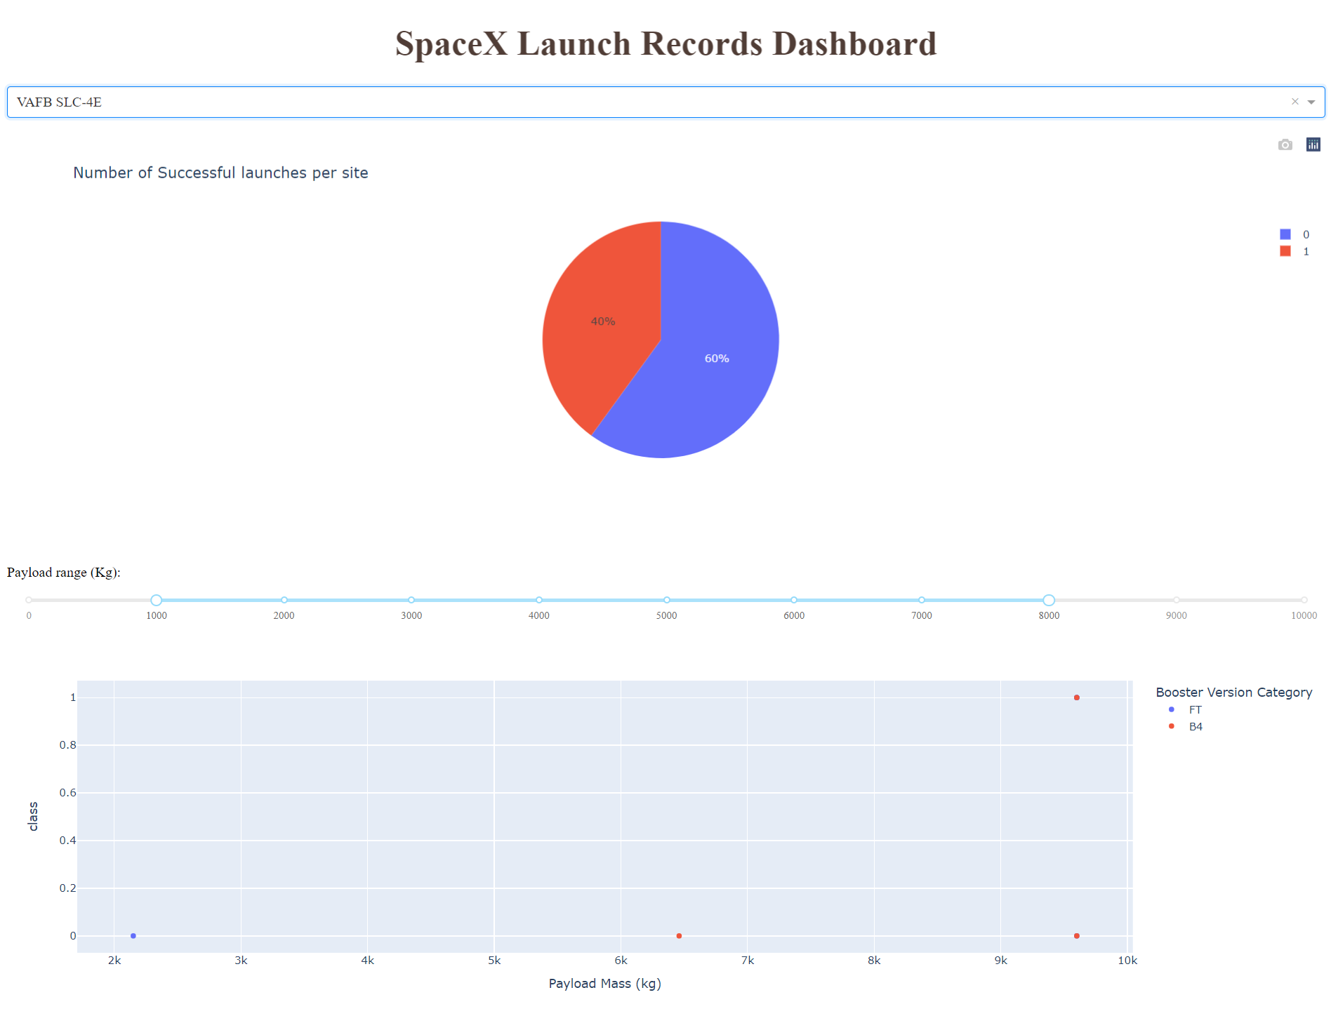
Results
Interactive analytics demo in screenshots

Slide 22
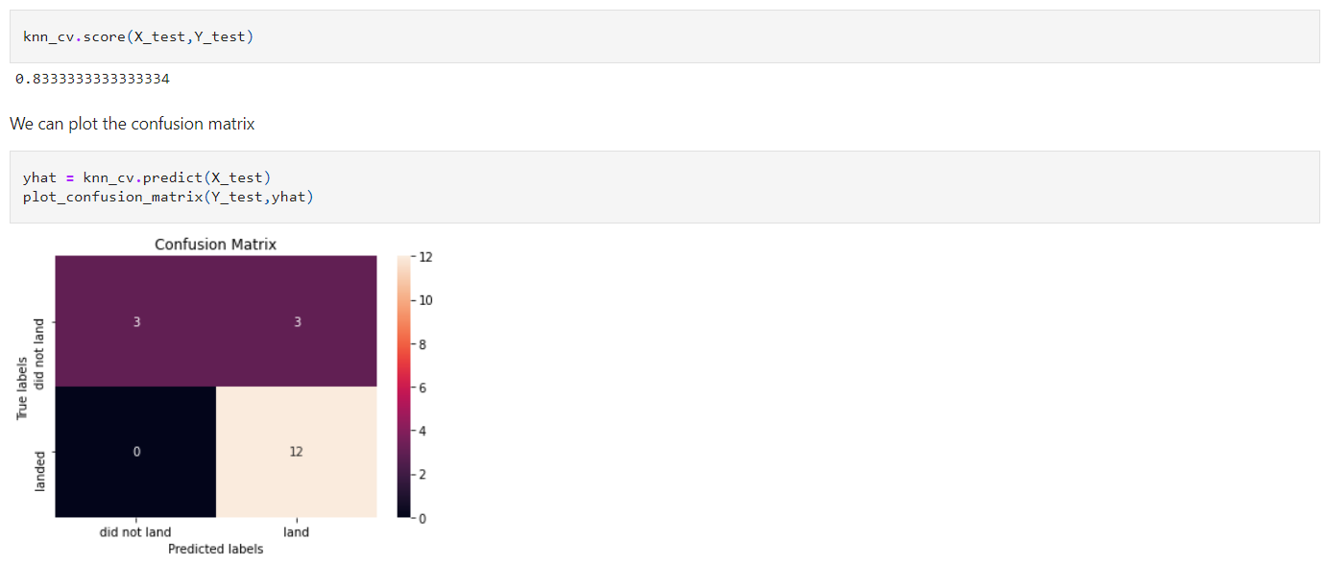
Results
Predictive analysis Results

Slide 23

Section 2

Slide 24
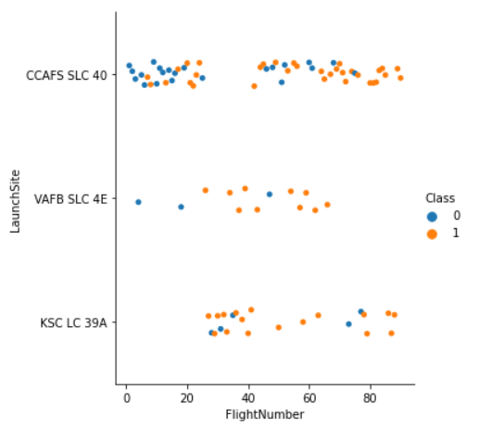
Flight Number vs Launch Site
The success rate of KSC LC 39 A and VAFB SLC 4E appears to be significantly more than CCAFS SLC 40 .

Slide 25
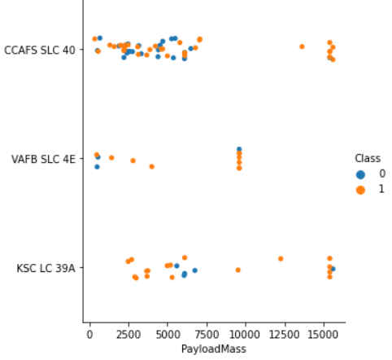
Payload vs Launch Site
The success rate of KSC LC 39 A and CCAFS SLC 40 appears to be significantly more than
VAFB SLC 4E for payload mass indicating that they are more suitable for heavy payload.

Slide 26
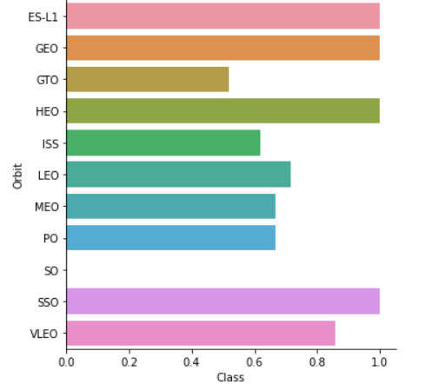
Success rate vs Orbit Type
The success rate of ES-L1,GEO ,HEO ,SSO and VLEO appears to be significantly more than others indicating that they are more suitable for launches. SO turns out to be most unsuitable orbit for rocket launches but it can be also due to lack of data as SO has had only one launch and that too had failed

Slide 27
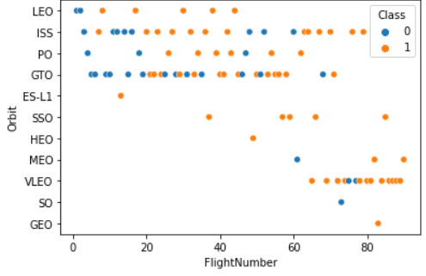
Flight number vs Orbit type
We can see that in the LEO orbit the Success appears related to the number of flights; on the other hand, there seems to be no relationship between flight number when in GTO orbit.

Slide 28
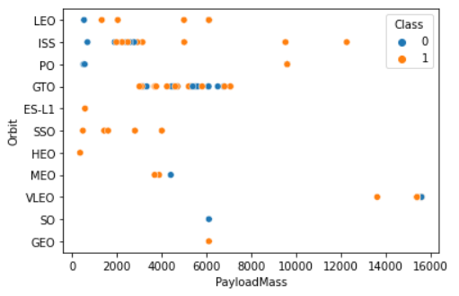
Payload vs Orbit type
SSO appears to be the best choice for payloads in range 0 to 4000kg while for higher
payloads ISS and VLEO appear to be a good choice for orbit.

Slide 29
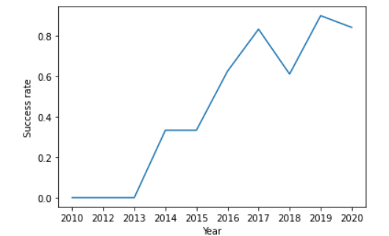
Payload vs Orbit type
The success rate appears to drastically change in the from the year 2013 and had taken
a significant dip in the year 2018.

Slide 30
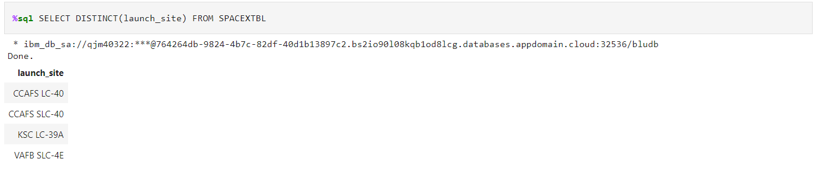
All launch site names
DISTINCT clause is used to show all the unique values in the column launch_site.

Slide 31
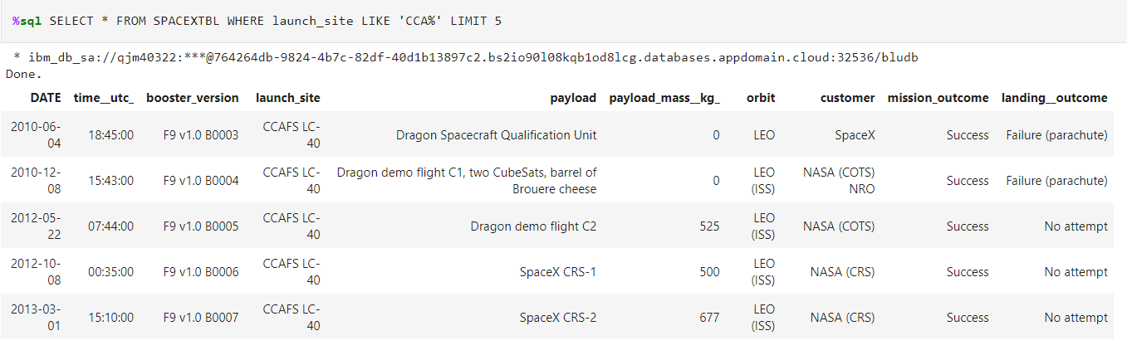
Launch Site Names Begin with ‘CCA’
LIMIT clause is used to restrict the number of rows/records to be displayed in this case to 5 .

Slide 32
Launch Site Names Begin with ‘CCA’
LIMIT clause is used to restrict the number of rows/records to be displayed in this case to 5 .

Slide 33
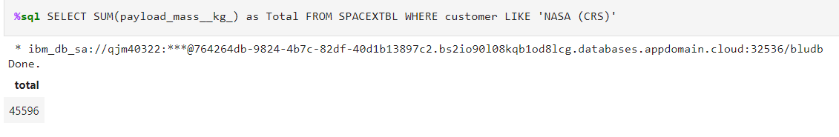
Total Payload Mass
SUM is used to sum the column payload_mass_kg_ , LIKE ‘NASA (CRS)’ is used to
allow only those rows where customer column value is ‘NASA (CRS)’.

Slide 34
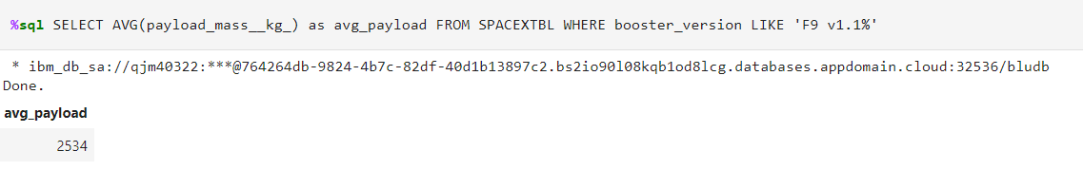
Average Payload Mass by F9 v1.1
AVG is used to average the column payload_mass_kg_ , LIKE ‘F9 v1.1%’ is used to
allow only those rows where booster_version column value is ‘F9 v1.1%’.

Slide 35
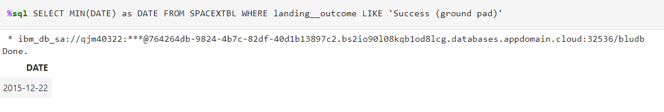
First Successful Ground Landing Date
MIN is used to find the minimum of the column DATE , LIKE ‘Success (ground pad)’ is used to allow only those rows where landing_outcome column value is ‘Success (ground pad)’.

Slide 36
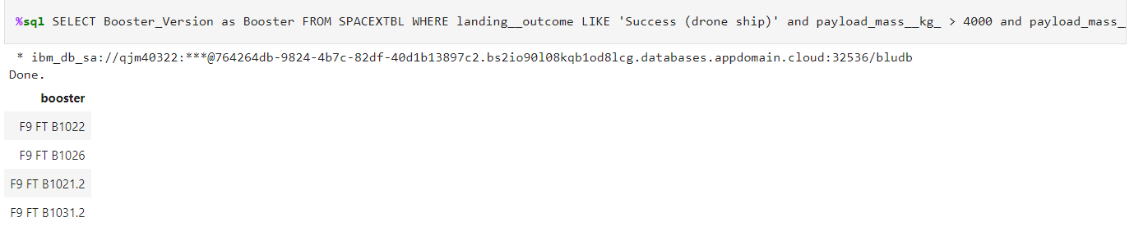
Successful Drone Ship Landing with Payload between 4000 and 6000
LIKE ‘Success (drone ship)’ is used to allow only those rows where landing_outcome column value is ‘Success (drone ship)’.

Slide 37
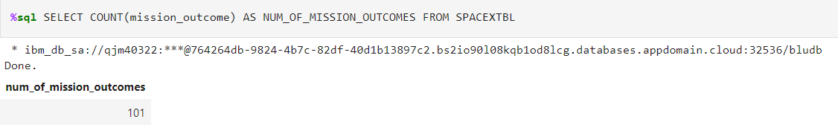
Total Number of Successful and Failure Mission Outcomes
COUNT is used find the number of values in a column in this case mission_outcome being the column.

Slide 38
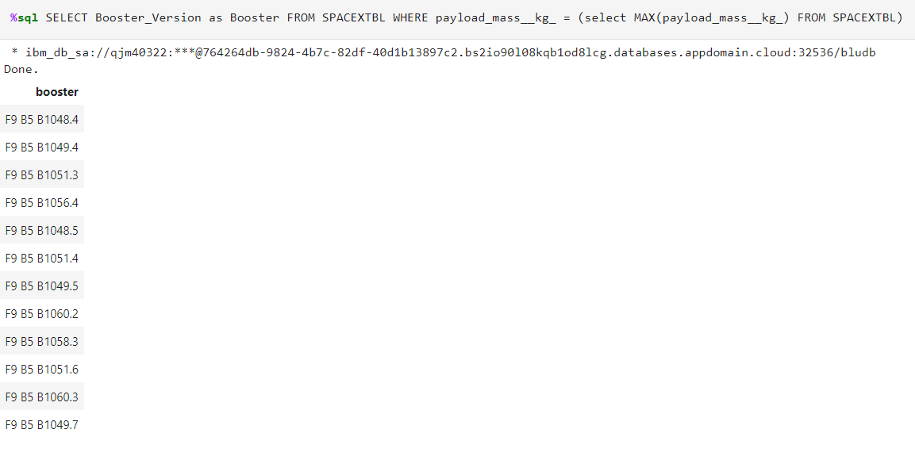
Boosters Carried Maximum Payload
MAX is used find the maximum value in a column in this case payload_mass_kg_ being the column and this max value is then compared with all the values of payload_mass_kg_
to find the booster version with maximum payload capacity.

Slide 39
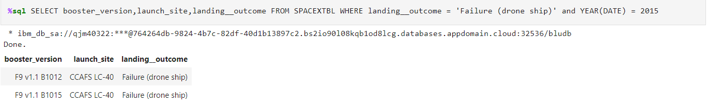
2015 Launch Records
YEAR is used to extract the year from the column DATE and to compare it against 2015
to find the booster version,launch_site and landing_outcome.

Slide 40
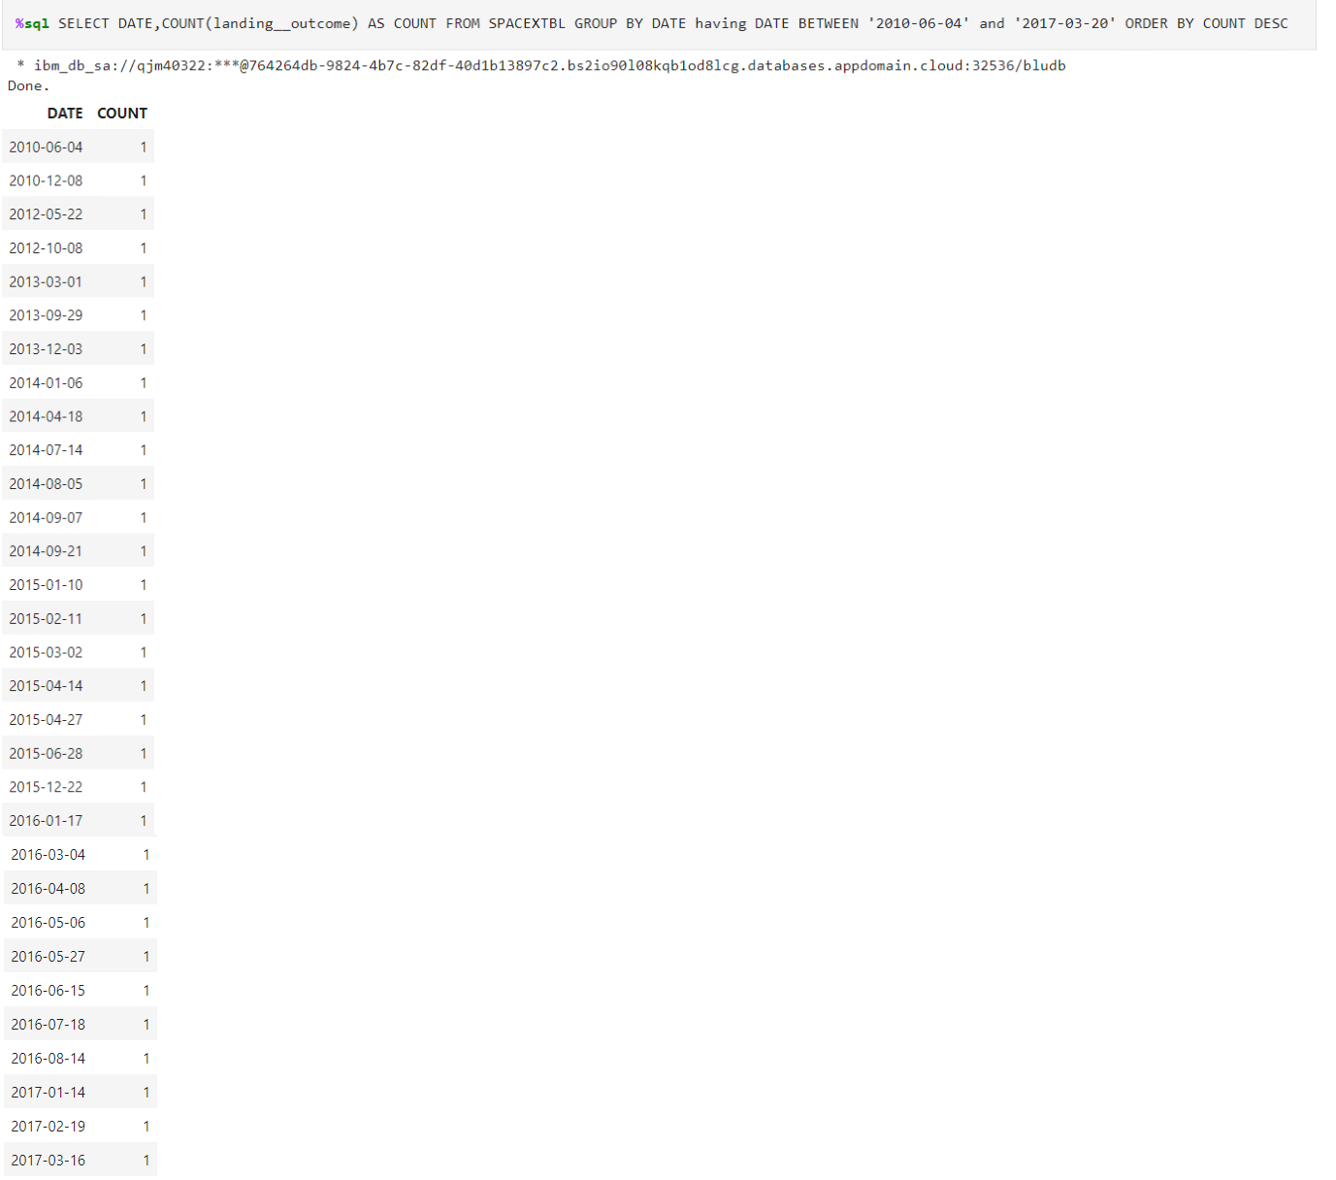
Rank Landing Outcomes Between 2010-06-04 and 2017-03-20
COUNT is used find the number of values in a column in this case landing_outcome being the column. GROUP BY is used to group by column DATE ,Having is used to add
the condition in GROUP BY clause and DESC is used to arrange the data in
descending order using count as column.

Slide 41

Section 3

Slide 42
Map Showing All the Launch Sites
The folium map shows 3 launch sites (CCAFS LC-40, CCAFS SLC-40, KSC LC-39A) on the east coast and one (VAFB SLC- 4E) on the west coast .

Slide 43
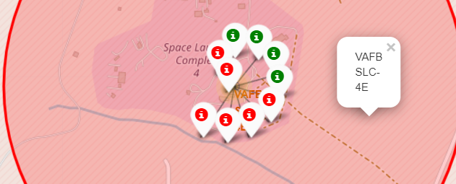
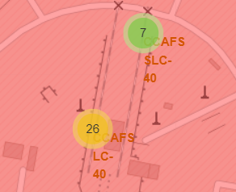
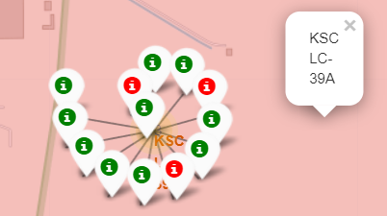
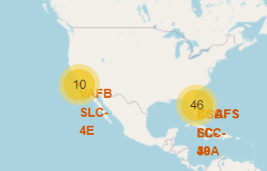
Maps Showing Successful and Failed Launches for Each Site
The above maps tell us the number of launches like VAFB SLC 4E
has 10 launches and 4 out of 10 were successful
CCAFS LC has 26 launches and CCAFS SLC-40 has 7 launches
KSC LC-39 A has 13 launches and 10 out of 13 were successful.

Slide 44
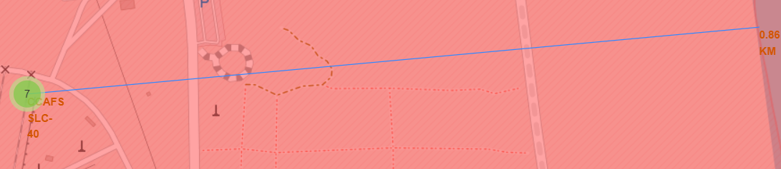
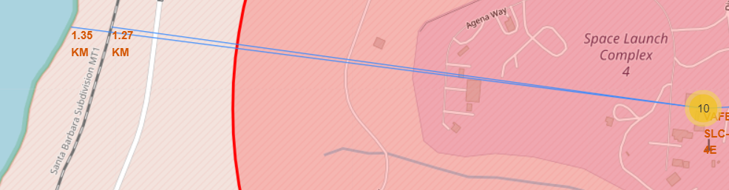
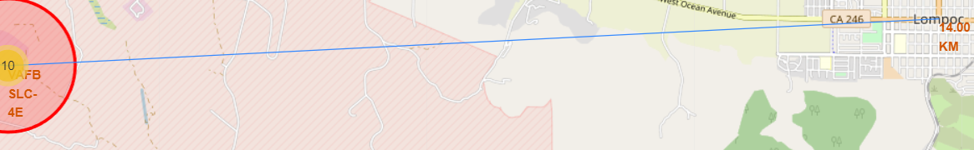
Map Showing Distance between launch site and its proximities

Slide 45
Map Showing Distance between launch site and its proximities
The first folium map shows the distance between CCAFS SLC-40 launch site
and its nearest coastline to be 0.86 KM.
The second folium map shows the distance between VAFB SLC- 4E launch site
and its nearest coastline to be 1.35 KM and to nearest railroad to be 1.27 KM .
The third folium map shows the distance between VAFB SLC- 4E launch site
and its nearest city (Lompoc) to be 14.00 KM.

Slide 46

Section 4

Slide 47
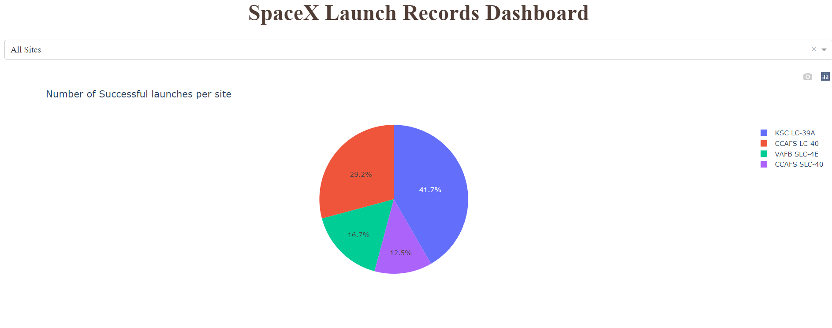
Pie Chart Showing Successful Launches per Site
The above pie chart shows that KSC LC-39A and CCAFS LC-40 account for the most
number of successful launches i.e they are the most suitable for launches.

Slide 48
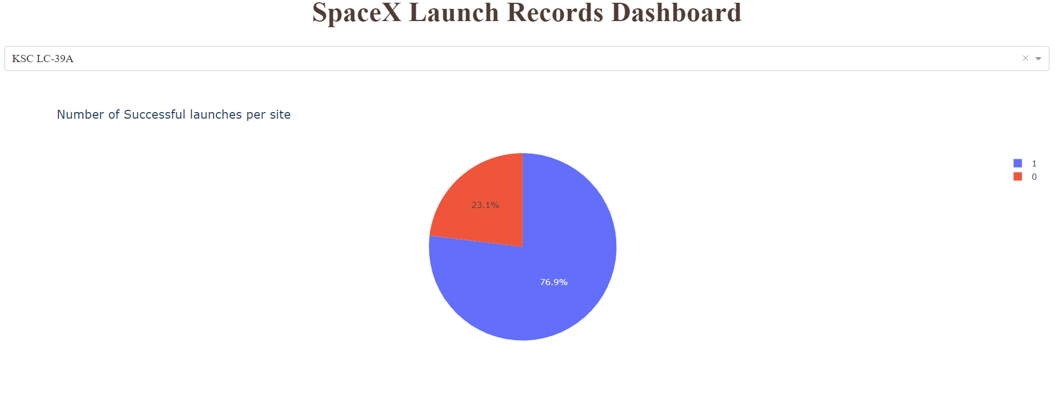
Pie Chart Showing Successful Launches at KSC LC-39A
The above pie chart shows that ~77% of launches at KSC LC-39A were successful.
.

Slide 49
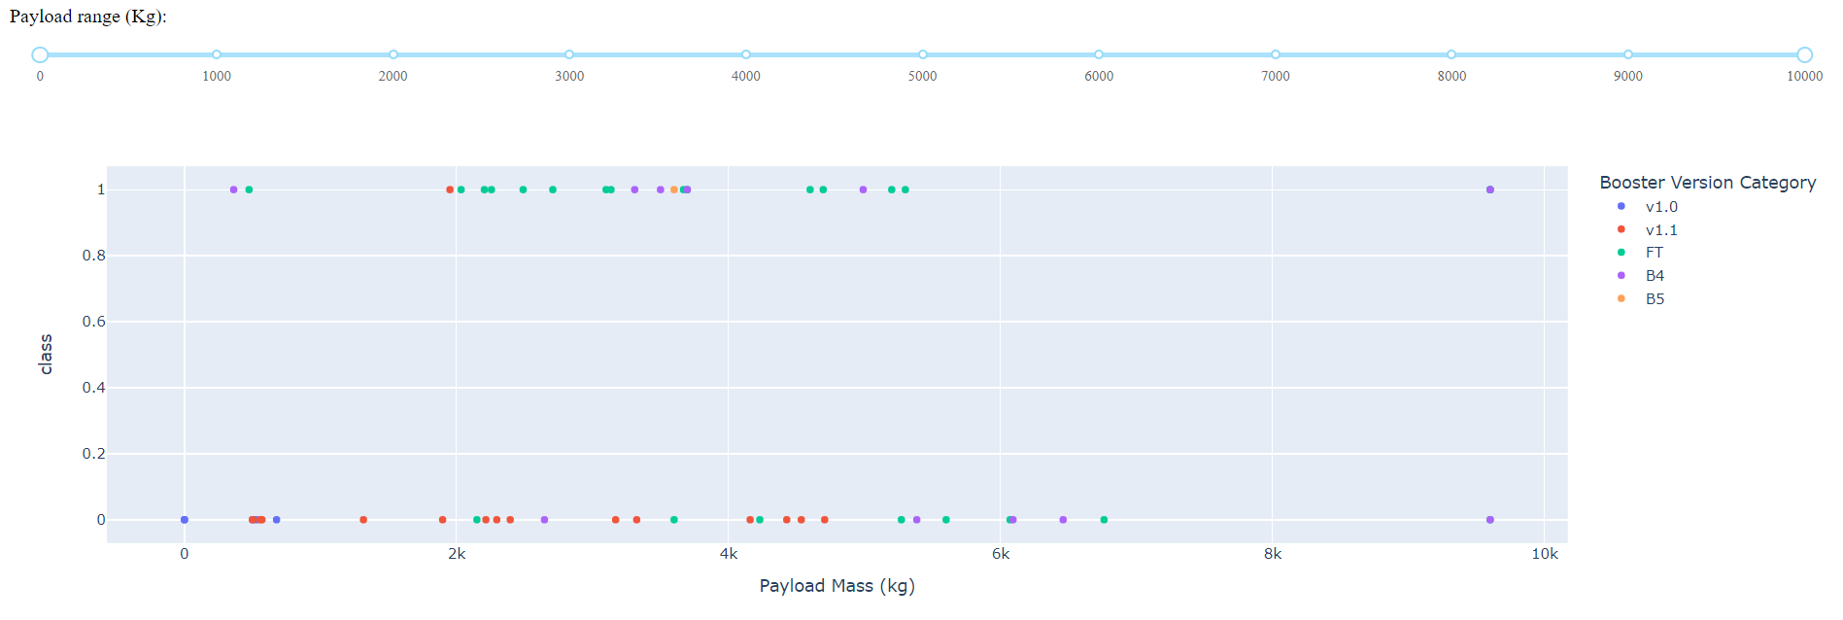
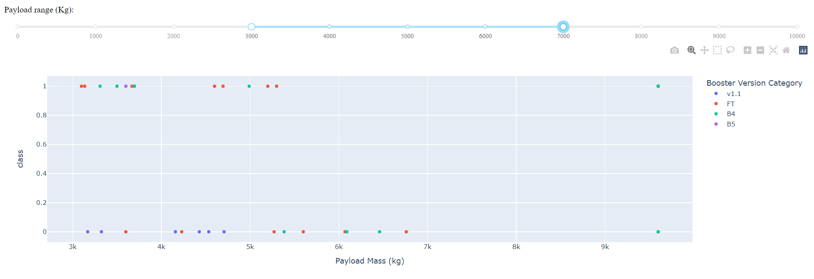
Scatter plot showing Successful launches vs Payload Mass

Slide 50
Scatter plot showing Successful launches vs Payload Mass
The first scatter plot shows that in the range 0 to 10000 ,the FT booster version
is the best choice while v1.1 tends to perform the worst.
The second scatter plot shows that in the range 3000 to 4000 ,the B5 booster version
is the best choice with no failed launches while v1.1 tends to perform the worst.

Slide 51

Section 5

Slide 52
Classification Accuracy
The above bar chart shows that all the models trained have accuracy of ~84%.
.

Slide 53
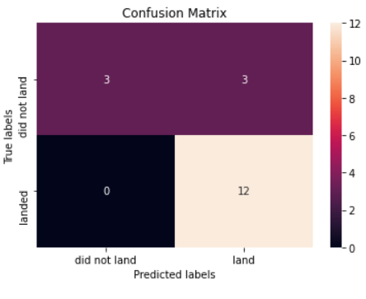
Confusion Matrix
The confusion matrix of KNN has 3 FP (false positive) which means that they were
classified as “land” even though “did not land” and 3 TN (true negative) which means
that they were classified as “did not land” when they were “did not land”. 0 FN
(false negative) which means all the values in “land” were classified correctly as “land”.

Slide 54
Conclusions
We trained a KNN model with ~84%,this was found to be the performing model which
was then used to predict the success rate of the launches.
We observed that FT Booster version performs best in the range 0 to 10000 KG payload.
We observed that KSC LC-39A and CCAFS LC-40 account for the most number of successful launches i.e they are the most suitable for launches.
We observed that he success rate of ES-L1,GEO ,HEO ,SSO and VLEO appears to be significantly more than others indicating that they are more suitable for launches.

Slide 55
Appendix
GitHub repo Link
Template Design Credits

Slide 56


